Slide 1
Introduction to AI
Exploring RAG, Hugging Face, LangChain, and AI

Slide 2
AI refers to machines designed to perform tasks that typically require human intelligence, such as understanding language, recognizing patterns, and making decisions. Fun Fact: The term "Artificial Intelligence" was coined in 1956 by John McCarthy at the Dartmouth Conference. Lesser-Known Fact: The first AI program, called the Logic Theorist, was created in 1955 and could prove mathematical theorems.

Slide 3
01
Evolution of Language Models

Slide 4
Early Days (1960s-1990s):
Rule-based systems like ELIZA (1966) and SHRDLU (1970).
Fun Fact: ELIZA could simulate a psychotherapist by using simple pattern matching, but it had no understanding of language.
Statistical Era (1990s-2010s):
Models like n-grams and Hidden Markov Models (HMMs).
Focused on probability and pattern recognition.
Lesser-Known Fact: Google’s early search algorithms relied heavily on n-grams.

Slide 5
Deep Learning Revolution (2010s-Present):
Introduction of neural networks and Transformers (2017).
Fun Fact: The Transformer architecture was introduced in the paper "Attention is All You Need" and revolutionized NLP by enabling models to process entire sentences at once.

Slide 6
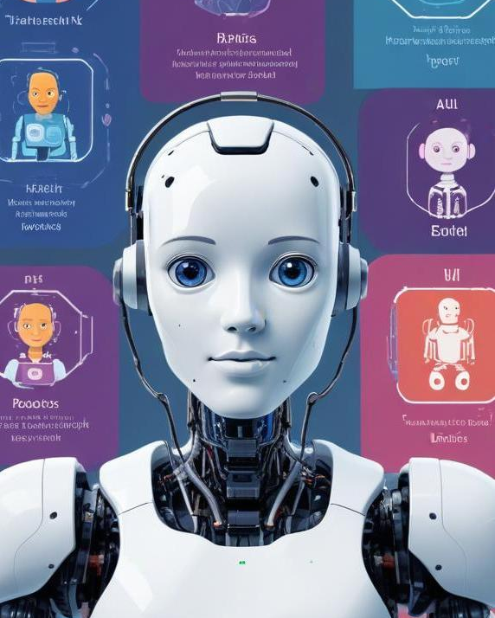
The Rise of LLMs
What are LLMs?
LLMs are large-scale neural networks trained on vast amounts of text data.
Examples: GPT-3, GPT-4, BERT, T5.
Fun Fact: GPT-3 has 175 billion parameters, making it one of the largest models ever created!
Why Size Matters:
Larger models can capture more nuanced language patterns.
Lesser-Known Fact: Training GPT-3 cost an estimated $4.6 million in computational resources.

Slide 7
The Emergence of LLMs Big Players in AI Space!
Model | Company | Owner / Backers | Year Introduced | Focus & Differentiation
ChatGPT (GPT-4) | OpenAI | Microsoft-backed, led by Sam Altman | 2023 | General-purpose, strong conversational AI with deep knowledge but some closed-source elements.
Gemini (formerly Bard) | Google DeepMind | Owned by Alphabet (Google's parent) | 2023 | Multimodal AI (text, image, audio), deeply integrated into Google Search & Workspace.
Claude | Anthropic | Founded by ex-OpenAI researchers, backed by Amazon & Google | 2023 | Focuses on safety, alignment, and trustworthiness in AI responses.
LLaMA | Meta (Facebook) | Mark Zuckerberg's AI push | 2023 (LLaMA 2: 2023, LLaMA 3 2024) | Open-source, optimized for research and efficiency. Expected LLaMA 3 in 2024.
Mistral | Mistral AI | A French AI startup | 2023 | Open-source and highly efficient, with Mixture of Experts (MoE) for smart routing.
Command R | Cohere | An AI model focused on enterprise use | 2023 | Designed for enterprise use (e.g., customer service, business applications).
Yi | Alibaba | A Chinese AI model competing globally | 2023 | China’s AI push, optimized for Mandarin and global AI competition.
GLM | Tsinghua University | China’s academic AI project | 2022 | Focuses on academic research and open AI development.
DeepSeek | DeepSeek AI | A Chinese AI company specializing in open-source LLMs | 2024 | Open-source, trained on multilingual datasets, and aims to compete with Western LLMs.

Slide 8
02
RAG and Vector DB

Slide 9
RAG (Retrieval-Augmented Generation)
What is RAG?
RAG combines retrieval-based methods with generative models to improve accuracy and relevance.
How it Works: The model retrieves relevant documents and then generates responses based on that information.
Fun Fact: RAG was introduced by Facebook AI in 2020 and is used in systems like ChatGPT to provide more accurate answers.

Slide 10
Hugging Face
03
What is Hugging Face?
Hugging Face is a company that provides open-source tools and models for NLP.
Fun Fact: The name "Hugging Face" comes from the emoji 🤗, symbolizing the friendly and approachable nature of the platform.
Key Contributions:
Transformers library: Simplifies the use of models like BERT and GPT.
Model Hub: A repository of pre-trained models.
Lesser-Known Fact: Hugging Face has over 100,000 models available for free!

Slide 11
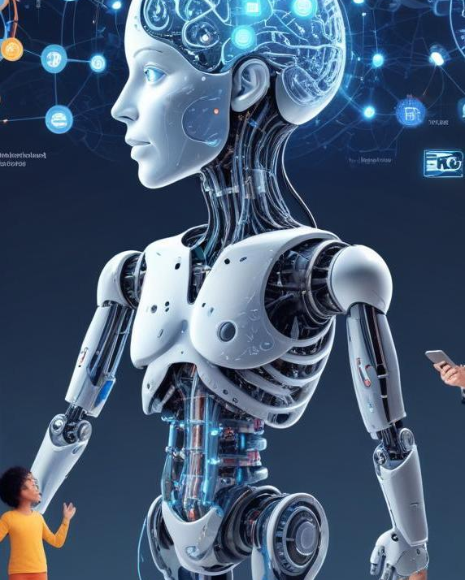
LangChain
04
What is LangChain?
LangChain is a framework for building applications powered by language models.
Key Features: Memory, context awareness, and integration with external data sources.
Fun Fact: LangChain was created by Harrison Chase in 2022 and has quickly become a favorite among developers.
Use Cases:
Chatbots, question-answering systems, and automated content generation.
Lesser-Known Fact: LangChain can integrate with tools like Google Search and Wikipedia to provide real-time information

Slide 12
AI Ethics and Challenges
Bias in AI models.
Environmental impact of training large models.
Fun Fact: Training a single LLM can emit as much carbon as 5 cars over their lifetimes!

Slide 13
Thank you!
Do you have any questions?

